Slide 1
Market Analysis using Power Bi
Capstone Project
Nico Tham Li De

Slide 2

Role
My role is of a Market Analysts hired by Company X. The task assigned was to review their Online store sales and give recommendations on how to improve their revenue.

Slide 3

Market Analysis Objective
Understanding the groups that our customer fall under.
Understanding the revenue earned over the years.
Identify purchase trends and patterns.

Slide 4
Data sets
Customer.csv
Contains customer details such as their name, gender and age
Purchase.csv
Contains order purchases made by customers with information such as the purchased item, quantity and ordered date.

Slide 5
Data Columns – Customer.csv
customer_id :
Unique ID given to each customer
first_name:
First name of each customer
last_name:
Last name of each customer
gender:
Gender of the customer
age:
Age of the customer
country:
The country that the customer is from
income:
The income of the customer

Slide 6
Numerical and Categorical Data- Customer
Numerical
Age
Income
Categorical
Gender
Income

Slide 7
Data Columns –Purchase.csv
order_id
Unique order id given to each purchase
customer_id
Id of the customer who made the purchase
product_name
Product purchased by the customer
description
A description of purchased product
price
Price of the product
discount
Discount given for the product
tax
Tax applied to the product
order_date
quantity
shipping_cost
shipping_date
The date which the purchase was made
The amount of the product that was purchased
The cost to ship the product
The date which the product will be shipped

Slide 8
Numerical and Categorical Data- Purchase
Numerical
Price
Discount
Tax
Quantity
Shipping cost
Categorical
Product Name

Slide 9
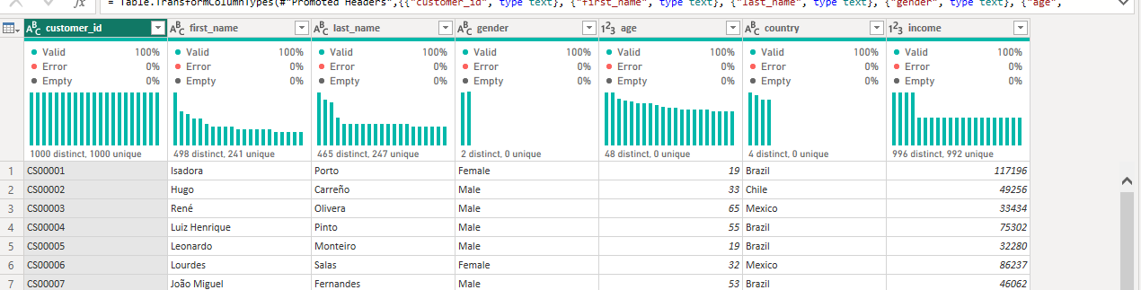
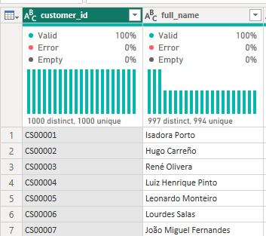
Data transformation - Customer
Merging of first_name and last_name column to form the full_name column

Slide 10
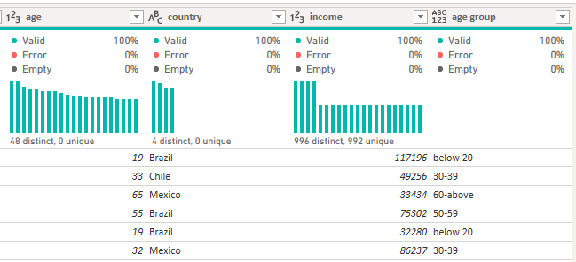
Data transformation - Customer
Adding of a conditional column to categorize age into different groups
Below 20
20-29
30-39
40-49
50-59
60 and above

Slide 11
Data transformation - purchase
Added a new calculation column through power bi to calculate the revenue earned from each purchase.
Formula
Revenue = (((purchase[price]-(purchase[price]*purchase[discount]))*(1+purchase[tax]))*purchase[quantity])+purchase[shipping_cost]
Breakdown
Revenue = ((Price – discount given + tax ) * quantity ) + shipping cost

Slide 12
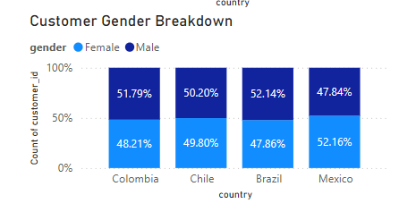
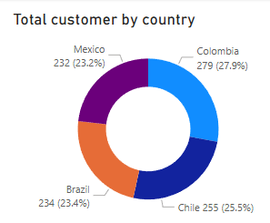
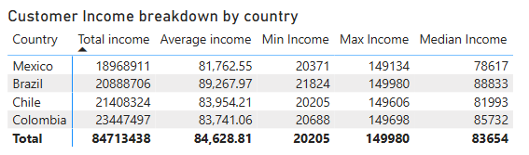
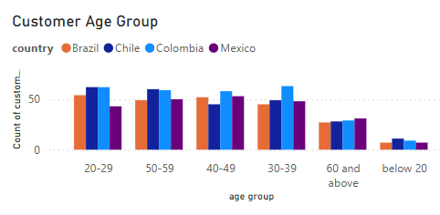
Understanding our customers
Gender:
The overall ratio of Male and Females is pretty even with it skewing slightly to Males.
Income:
The average income shows that Brazil customer’s are more well off than other countries but has lower amount of customers.
Age Group:
Majority of the customer are amongst the age of 20 - 59
Quantity:
The biggest bulk of our customer is from Columbia with Chile coming in second

Slide 13
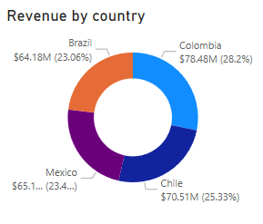
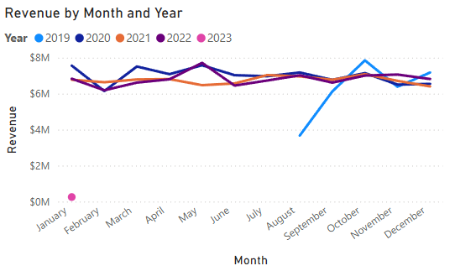
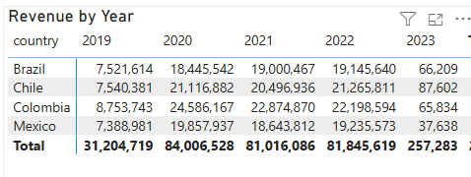
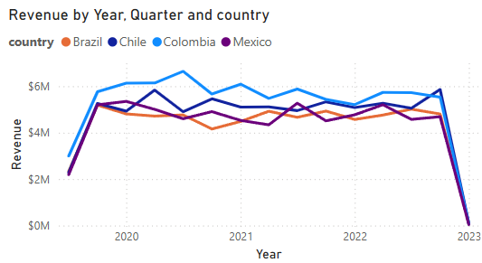
Understanding Revenue earned
Highest earning Country:
The country with the highest revenue was Colombia
Highest rise period:
The highest rise in revenue was from August 2019- October 2019 with the monthly revenue going from below $4M earned to almost $8M earned.
Highest drop period:
The highest drop in revenue was the transition from December 2022 to Jan 2023 with every country revenue dropping under 100k from millions.

Slide 14
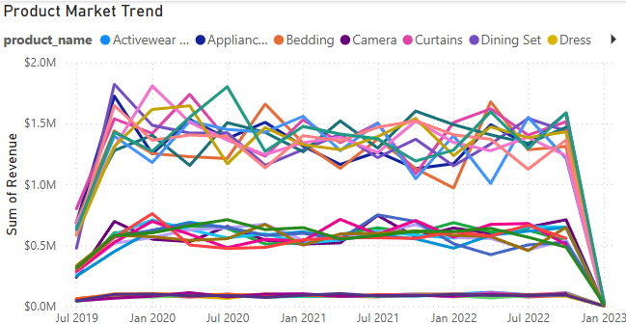
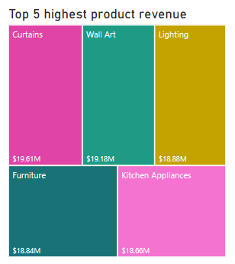
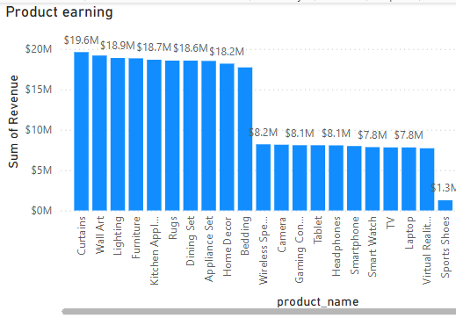
Identifying purchase trend and pattern
Highest earning products:
From the market trend and product earning it is apparent that products which function as home décor and appliances have the highest earning throughout the years.
Quantity Sold:
The total quantity of each product sold is relatively similar with it ranging from 8.6k units to 9.6ks units.
Lowest earning product:
Products that function as clothing and footwear have the lowest earning.
Despite the similar amount of quantity in sales, there is a huge disparity in the earnings between the highest and lowest earning. This is likely due to the price of the products

Slide 15
Recommendations base on analysis
Introduce
Introduce products designs targeting the specific age group
By comparing a product to its worst selling age group, we can introduce more suitable product designs for that age group hence possibly seeing an increase of sales for that product.
Research on
Research on products designs for the Brazilian market
Brazil has a lower revenue count than Mexico despite being wealthier and having more orders. This could be because they are mostly purchasing items of lower price. By releasing designs more suitable for the Brazilian market, we may see an increase in higher priced products hence increasing the revenue.
Consider
Consider raising the prices for clothing and foot wear products.
The market trend shows that there is a constant steady revenue for these products, we can try raising the price of the products to test its elasticity. If the product has high elasticity, we will see a higher increase in the revenue.
Investigate
Investigate the reasons for drop in revenue when transiting to 2023
From the dataset visualization, it is very apparent that there is a massive decrease in sales across all branches despite it maintaining a steady revenue of over 80 million per year and a couple of millions per month from 2019-2022. This is highly due to external or internal reasons which should be investigated.

Slide 16
Challenges faced
Topic selection
The dataset I chose have a very open range of topic I could go for, but I was lost as to where to start. I decided to dive into what data visualization I could create first using powerBI and python first, from there I went on with what I was more comfortable with.
Data representation
I understood what topic I would show on my visualization but I was unsure how much exactly do I need to show and what. I had to do research on sales report online to get ideas and was constantly trying different charts.

Slide 17

Opportunities
If given additional time, I would have like to explore more using python on things such as regression, correlation and machine learning to gain more experiences.
If I was given additional resources, I would have like information such as the cost price of the products so I can better re-evaluate the earnings of each product and craft more suitable and accurate recommendations to the client.

